Slide 1
Readmission & Multi-Admission Patient Reduction Workbook

Slide 2
Instructions for Using this Workbook
This workbook is meant to be interactive. Look for the grey boxes where you can click to type in your notes directly on the slide or add in screenshots, attachments, hyperlinks, file names/paths, etc. that are relevant to your project.
You can also Ctrl+Click on the hyperlinks or pictures of external resources to open them. Make sure you save your work in the external resources and send a copy to your Telligen Quality Improvement Facilitator along with this workbook.

Slide 3
Welcome
Please complete this project workbook in its entirety. At the end of the collaborative, your workbook will contain all the necessary elements to create a project poster.
We recommend saving all project materials to a designated folder on your work computer. Be sure to save your signed commitment form for the collaborative there, too.
Org Name:
Team Leader:
Senior Leadership Project Sponsor:
Insert here
Insert here
Insert here
This slide corresponds to the “Title Page” section of your Collaborative Poster.

Slide 4
Objectives
Develop an individualized, multidisciplinary program with clearly defined goals, process and outcome measures aimed at preventing hospital readmissions and reducing multi-admission patient utilization.
Identify hospital available data sources and develop a process for analyzing readmission data, identifying multi-admission patients and assessing risk for readmission.
Practice root cause analysis to inform the selection of evidence-based interventions that adequately address multi-admission patient factors.
Implement customized interventions in real time while learning to evaluate effectiveness and make improvements that respond to your facility’s unique needs.
Develop and implement methods for engaging staff, providers, patients, families and community organizations in preventing readmissions.

Slide 5
Plan What are we trying to accomplish?

Slide 6
Relevant Project Definitions
Unplanned Readmission: Inpatients returning as an acute care inpatient within 30 days of date of an inpatient discharge, to any facility, with the exception of certain planned admissions
Multi-Admission Patient: A Medicare beneficiary who has four or more inpatient claims or five or more combination of emergency department, observation or inpatient claims within a 12-month period
Ctrl+Click for the Measure Core Set Informational Guide.
Measure Specification Information Guide

Slide 7
Huang, M., van der Borght, C., Leithaus, M.et al. Patients’ perceptions of frequent hospital admissions: a qualitative interview study with older people above 65 years of age. BMC Geriatr 20,332 (2020). https://doi.org/10.1186/s12877-020-01748-9
Jencks, S., Williams, M., Coleman, E. (2009). Rehospitalizations among patients in the Medicare fee-for-service program. The New England Journal of Medicine 360, 1418-1428. DOI: 10.1056/NEJMsa0803563

Slide 8
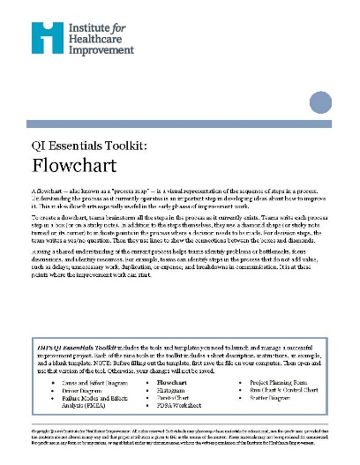
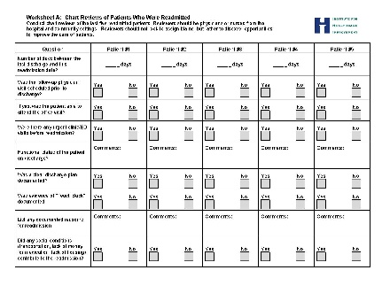
Ctrl+Click to use a flowchart template.
https://www.ihi.org/resources/Pages/Tools/Flowchart.aspx
https://www.telligenqiconnect.com/wp-content/uploads/2023/02/IHI-Flow-Chart-Template.pdf
https://www.telligenqiconnect.com/wp-content/uploads/2023/02/ReadmissionsDiagnosticTool_STAAR.pdf
Ctrl+Click for a template to perform chart reviews of patients who were readmitted.

Slide 10
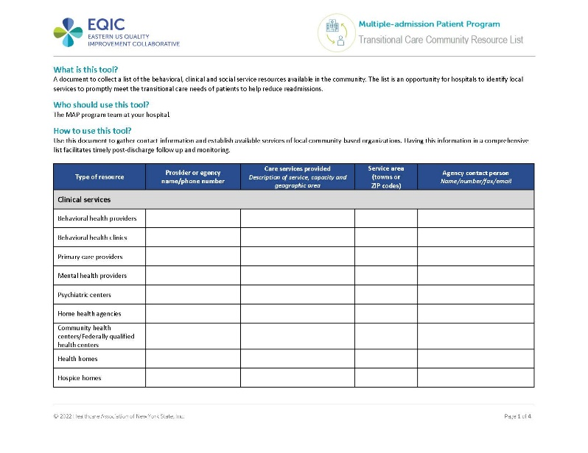
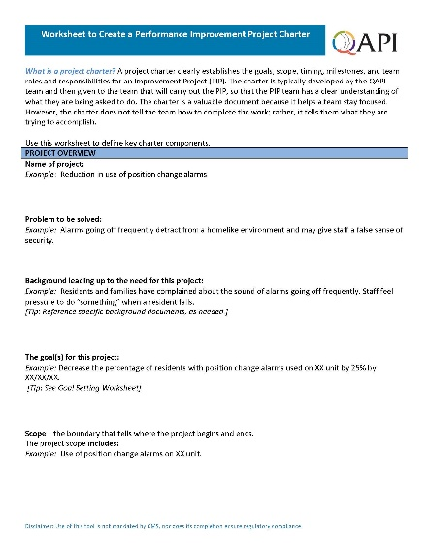
Ctrl+Click for a template to document a list of behavioral, clinical and social service resources available in your community.
Ctrl+Click for a worksheet to create a performance improvement project charter.
https://www.telligenqiconnect.com/wp-content/uploads/2023/02/2022-06-13_transitional_care_community_resource_list.docx
https://www.telligenqiconnect.com/wp-content/uploads/2022/05/Create-a-Performance-Improvement-Project-Charter-fillable.pdf

Slide 12
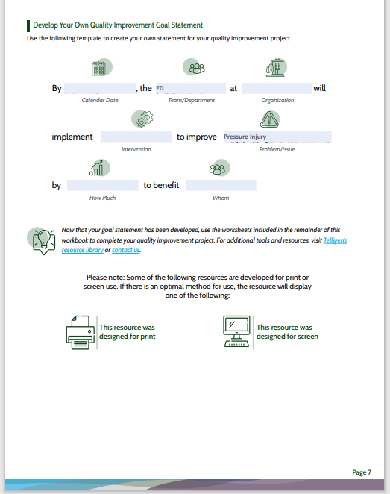
Ctrl+Click for a template to develop your AIM statement (page 7).
Quality Improvement Workbook | Telligen

Slide 14
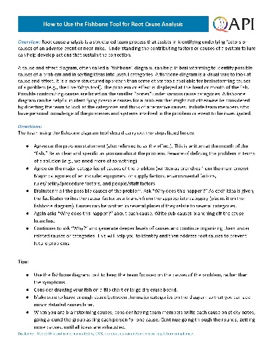
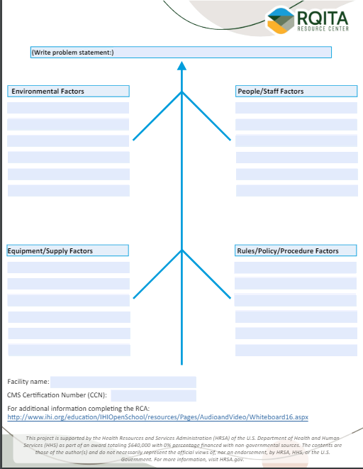
Ctrl+Click for detailed instructions on using the fishbone tool for root cause analysis.
Ctrl+Click for a fishbone diagram template.
https://www.cms.gov/Medicare/Provider-Enrollment-and-Certification/QAPI/Downloads/FishboneRevised.pdf
https://www.telligen.com/wp-content/uploads/2024/03/Fishbone-Diagram.pdf

Slide 15
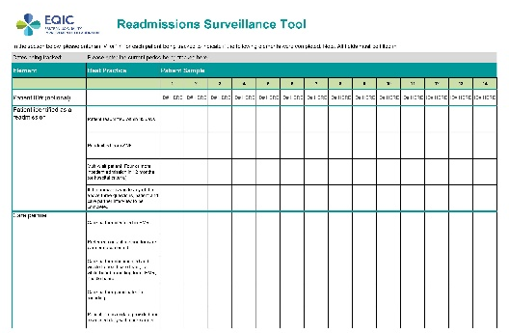
Ctrl+Click for the assessment summary.
Quality Improvement Workbook | Telligen
https://qualityimprovementcollaborative.org/focus_areas/readmissions/
Ctrl+Click for a readmissions surveillance tool.

Slide 16
Do What changes can we make that will result in improvement?

Slide 17
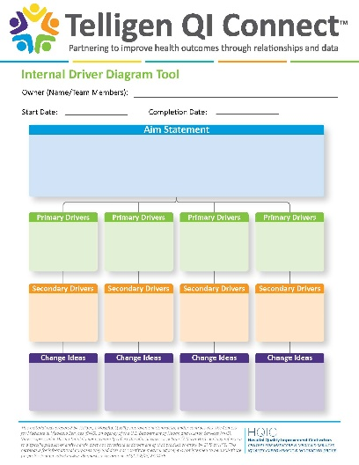
Ctrl+Click for a driver diagram template.
Driver Diagram | Telligen

Slide 18
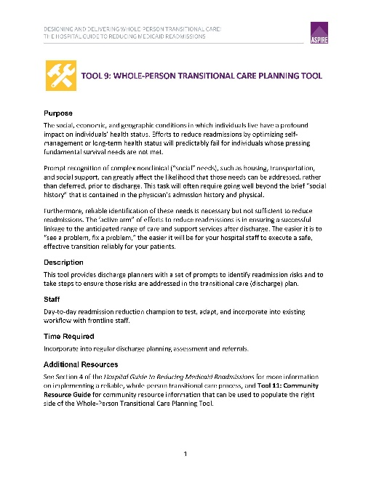
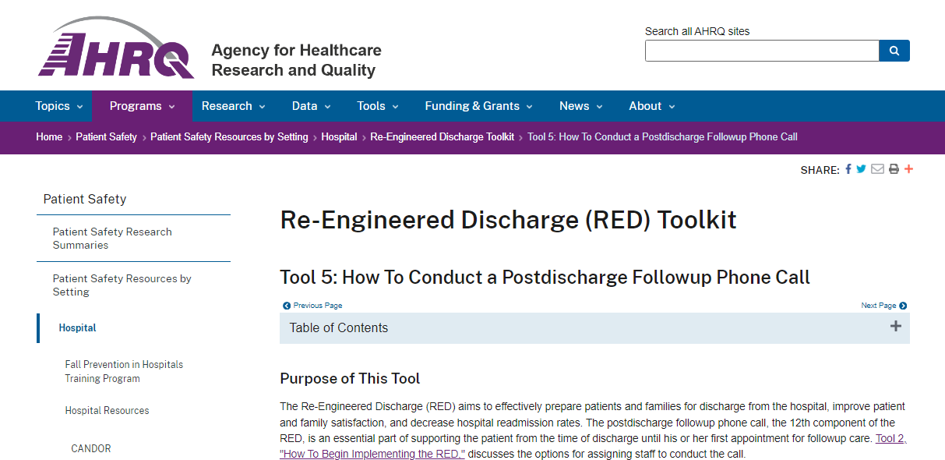
Ctrl+Click for the whole-person transitional care planning tool.
Whole-Person Transitional Care Planning Tool
Re-Engineered Discharge (RED) Toolkit | AHRQ
Ctrl+Click for the AHRQ Re-Engineered Discharge (RED) Toolkit.

Slide 19
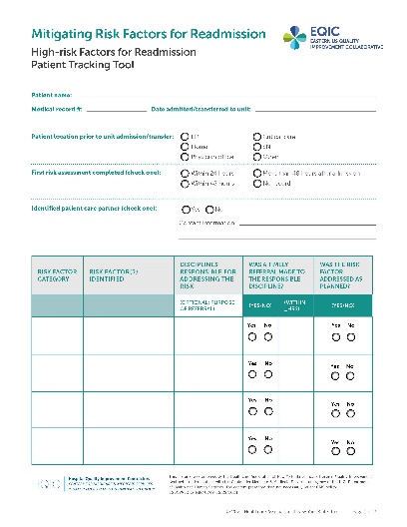
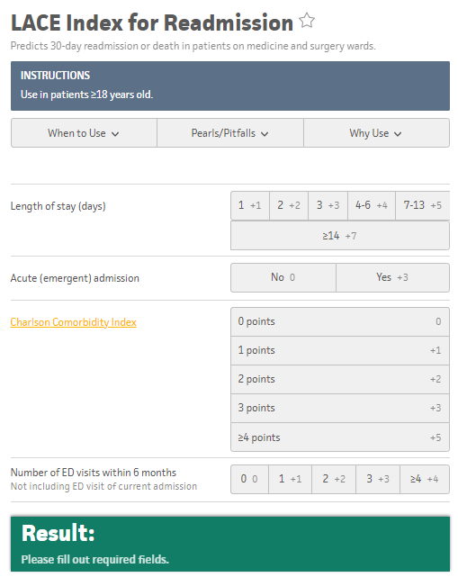
Ctrl+Click for the high-risk factors for readmission patient tracking tool.
Ctrl+Click for the LACE Index for Readmission tool.
https://qualityimprovementcollaborative.org/focus_areas/readmissions/docs/mitigating_risk_factors_for_readmission.pdf
https://www.mdcalc.com/calc/3805/lace-index-readmission

Slide 20
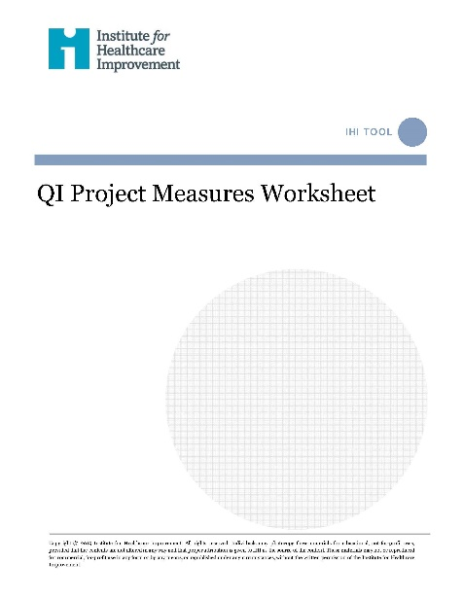
Ctrl+Click for the IHI Quality Improvement Project Measures Worksheet.
https://www.telligenqiconnect.com/wp-content/uploads/2023/02/QI-Project-Measures-Worksheet.pdf

Slide 21
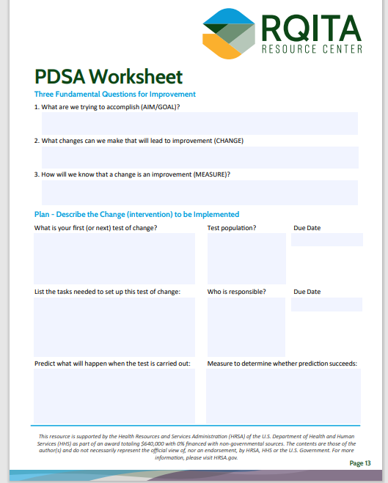
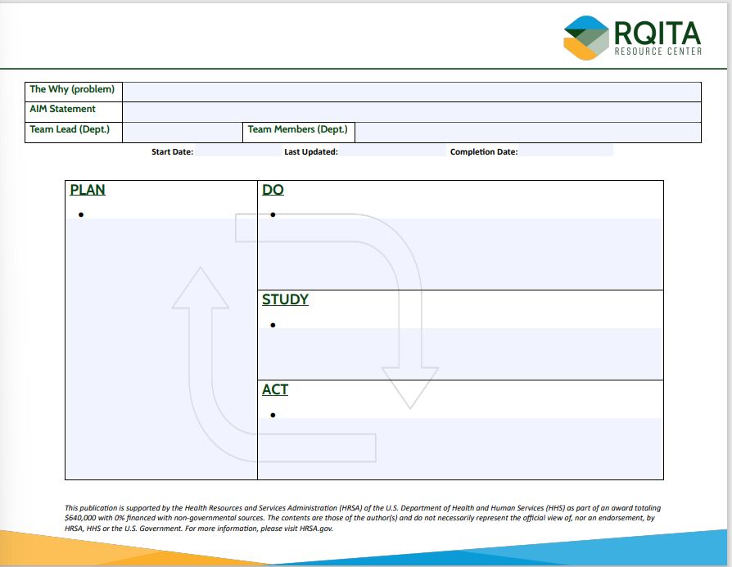
Ctrl+Click for a Plan-Do-Study-Act (PDSA) Planning Worksheet example.
Quality Improvement Workbook | Telligen
PDSA Tools | Telligen
Ctrl+Click for a PDSA Working Tool

Slide 23
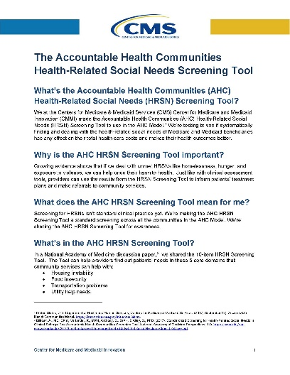
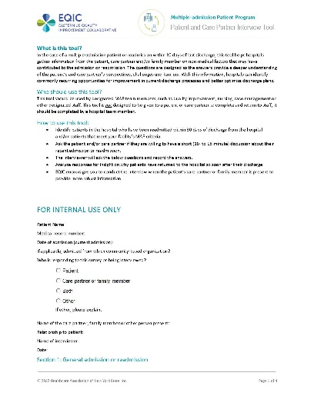
Ctrl+Click for the Accountable Health Communities Health-Related Social Needs Screening Tool.
Ctrl+Click for a patient and care partner interview tool.
https://innovation.cms.gov/files/worksheets/ahcm-screeningtool.pdf
https://www.telligenqiconnect.com/wp-content/uploads/2023/02/2022-06-13_patient_and_care_partner_interview_tool.docx

Slide 24
Study Has the current state changed?

Slide 27
Act Was our intervention successful? How can we modify to create more improvement?

Slide 28
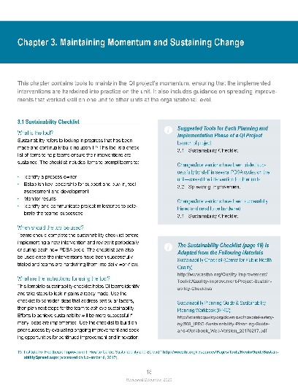
Ctrl+Click to complete a sustainability checklist.
https://www.telligenqiconnect.com/wp-content/uploads/2023/02/NYSPFP_PatientSafety_Toolkit_Sustainability-Checklist.pdf

Slide 29
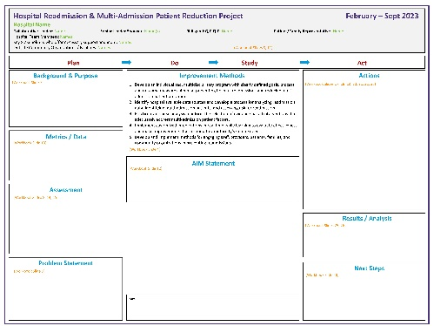
Ctrl+Click for a poster template.
https://www.telligenqiconnect.com/wp-content/uploads/2023/02/Readmissions-Collab-Poster-Template-Draft_-add-Abstract-and-Charter-detailsv2.pptx

Slide 33
Thank You!

